Slide 1
Phases of Data
Pravin Y Pawar
Adapted from
Reliable Machine Learning
By Chen, Murphy, Sculley, Underwood

Slide 2
Data Management
The data management stage is about transforming the data into a format and storage organization suitable for using it for later stages of the process
During this process
may apply a range of data transformations that are model specific to prepare the data for training
next operations on the data will be to train ML models, anonymize certain sensitive items of data
delete data when we no longer need it or are asked to do so
To prepare for these operations on the data,
take input from the business leaders to answer questions about primary use cases for the data
explore possible areas for future exploration

Slide 3
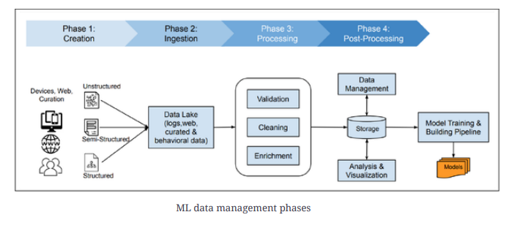
Phases of Data
Data management in modern ML environments consists of multiple phases before feeding the data into model-training pipelines
Creation
Ingestion
Processing (which includes validation, cleaning, and enrichment)
Post-processing (which includes data management, storage, and analysis)

Slide 4
Phases of Data(2) - Creation
Sources
Odd or obvious to state, but ML training data comes from somewhere
Datasets are all created at some point via some process
The process of generating or capturing the data in some data storage system but not our data storage system
Examples - logs from serving systems, large collections of images captured from an event, diagnostic data from medical procedures
Some datasets work well when they are static (or at least don’t change quickly), and others are useful only when frequently updated
For example,
A photo-recognition dataset, may be usable for many months, as long as it is suitably representative of the types of photos would like to recognize with model.
On the other hand, if the outside photos represent only winter environments from a temperate climate, the distribution of the photo set will be significantly diversified

Slide 5
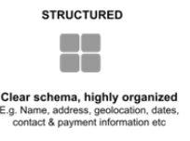
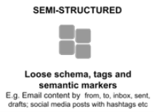
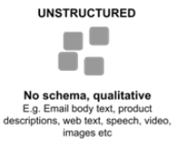
Phases of Data(3) - Creation
Kinds of data
Structured data
quantitative with a predefined data model/schema, highly
organized, and stored in tabular formats like spreadsheets
or relational databases
can be easily processed by relatively simple code using
obvious heuristics.
Unstructured data
qualitative without a standard data model/schema
cannot be processed and analyzed using conventional data
methods and tools
Semi-structured data
doesn’t have a specific data model/schema but includes tags
and semantic markers
a type of structured data that lies between structured and
unstructured data
The character of the internal structure of the data will have
significant implications for the way we process, store, and use it.

Slide 6
Phases of Data(4) - Creation
Dataset augmentation
Small amount of training data is available - not enough to train a high-quality model on
then need to augment that data
Tools are available that can do so
For example, Snorkel
is one good place to start, as it allows us to easily expand a small dataset into a large one
has good evidence that this approach can yield extremely good results at low cost, although it does
need to be used with caution

Slide 7
Phases of Data(5) - Ingestion
Filter / Selection / Sampling
The data needs to be received into the system and written to storage for further processing
not all data created may be ingested or collected, because we don’t want or need to
a filtering and selection step necessarily occurs
Sampling
may also simply sample at this stage if have so much data which can not be processed all of it
as ML training and other data processing is often extremely computationally expensive
an effective way to save money on intermediate processing and training costs
important to measure the quality cost of sampling and compare that to the savings
is likely to occasionally loose some detail for some events – unavoidable!
In general, ML training systems perform better with more data. Any reduction in data may well impact quality at the same time as reducing costs.

Slide 8
Phases of Data(6) - Ingestion
Mechanism
Depending on the volume of data and the complexity of our service, the ingestion phase
may be as simple as “dump some files in that directory over there”
or as sophisticated as a remote procedure call (RPC) endpoint that receives specifically formatted files and confirms a reference to the data bundle that was received so that its progress through the system can be tracked
Reliability concerns during the ingestion phase typically focus on correctness and throughput
Correctness is the general property that the data is properly read and written in the correct place without being unnecessarily skipped or misplaced
Monitoring the existence and condition of data before and during ingestion is the most difficult part of the data pipeline.

Slide 9
Phases of Data(7) - Processing
Validation
Set of common operations to make the data ready for training
Validation
cleaning and ensuring data consistency
enriching and extending
Validation
Efficient and powerful ML models can never do what we want them to do with bad data
In production, a common reason for errors in the data is bugs in the code that is collecting the data in the first place
Data ingested from external sources might have a lot of errors
extremely important to validate the incoming data especially when there is a well-defined schema and/or an ability to compare against the last known valid feed
performed against a common definition of the field
need to both store and be able to reference those standard definitions

Slide 10
Phases of Data(8) - Processing
Cleaning and ensuring data consistency
Even with a decent validation framework in place, most data is still messy
may have missing fields, duplicates, misclassifications, or even encoding errors
more data we have, the more likely that cleaning and data consistency will be its own stage of
processing
ML pipeline will assuredly have code whose job is to clean the data
can either put this code in a single place, where it can be reviewed and improved,
or put aspects of it throughout the training pipeline
Another set of data consistency tasks during this portion is the normalization of data
refers to a set of techniques used to transform the input data into a similar scale
Common technique is that of putting the data into buckets
map a range of data into a much smaller set of groups that represent the same range

Slide 11
Phases of Data(9) - Processing
Enriching and extending
Enriching
Combine data with data from other sources
Labeling
most common and fundamental way to extend the data
identifies a given event or record by bringing in confirmation from an outside source of data (sometimes
a human)
Labeled data is the key driver of all supervised ML and is often one of the most challenging and
expensive parts of the whole ML process
Joins
Might use many external data sources to extend training data

Slide 12
Phases of Data(10) - Post-processing
Storage
Need to store the data somewhere
How and where we store the data is mostly driven by how we tend to use it
which is really a set of questions about training and serving systems
Two predominant concerns here:
efficiency of storage
metadata
The efficiency of a storage system is driven by access patterns
that are driven by the model structure, team structure, and training process
Metadata helps humans interact with the storage
When multiple people work on building models on the same data (or when the same person works on this
over time), metadata about the stored features provides huge value
Roadmap to understanding how the last model was put together and how we might want to put together the
model
More commonly undervalued parts of an ML system.

Slide 13
Phases of Data(11) - Post-processing
Management
Data management system is primarily motivated by two factors
The business purpose to which we intend to put the data
What problem are we trying to solve?
What is the value of that problem to our organization or our customers?
The model structure and strategy
What models do we plan to build?
How are they put together?
How often are they refreshed?
How many of them are there?
How similar to one another are they?
Every choice we make about our data management system is constrained by, and constrains, these two factors!
If data management is about how and why we write data, ML training pipelines are about how and why we read it.

Slide 14
Phases of Data(12) - Post-processing
Analysis and Visualization
Process of transforming large amounts of data into an easy-to-navigate representation using statistical and/or graphical techniques and tools
Essential task of ML architectures and knowledge discovery techniques to make data less confusing
and more accessible
Not enough just to show a pie chart or bar graph
Need to provide the human reader an explanation of
what each record in the dataset means,
how it is linked with the records in other datasets
and whether it is clean and safe to use for training models
Practically impossible for data scientists to look at large datasets without well-defined and high-
performant data visualization tools and processes

Slide 15
Thank You!
In our next session:

